Slide 1

Olist Store Data Analysis Project
Insights and Recommendations for Improved Performance
Presented by Data Pioneers Team

Slide 2
Project Members
Ali M
Abdi S
Ailin G
Michelle W
Muhammod S
Sharifa S

Slide 3
Agenda
1. Introduction
4. Dataset Overview
5. Insights and Findings
6. Recommendations
7. Conclusion and Next Steps
2. Key Questions and Analysis
3. Data Cleansing

Slide 4
Introduction
- About Olist Store: Largest online department store in Brazilian marketplaces.
- Project Objective: To analyse Olist's dataset and provide actionable insights to enhance business performance.
- Deliverables:
- Power BI Dashboard
- Comprehensive Report
- Final Presentation

Slide 5
Key Questions & Analysis
Feedback Sentiment Analysis. Evaluate the polarity of the tweets as customer feedback positive, negative or neutral?
Clustering. Some customers did not write a review. But for those that did, why are they happy or mad?
Sales Prediction. With purchase date information you will be able to predict future sales.
Delivery Performance. You will also be able to work through delivery performance and find ways to optimise delivery times.

Slide 6
Key Questions and Analysis
- Customer Demographics: Who are the customers?
- Sales Trends: What are the sales trends over time?
- Product Categories: Which categories perform best?
- Delivery Performance: How efficient is the delivery process?
- Customer Feedback: What do reviews reveal about customer satisfaction?

Slide 7
Data cleansing
Google Docs
Libraries used:
Matplotlib
Python (Pandas)
Seaborn
Pyodbc
Google Translate
.Excel

Slide 8
Dataset Overview
- Data Description:
- 100,000 orders (2016-2018)
- Features include:
- Customer demographics
- Order status
- Payment details
- Freight performance
- Customer reviews
- Integrated Geolocation Data: Brazilian zip codes mapped to latitude and longitude.

Slide 9
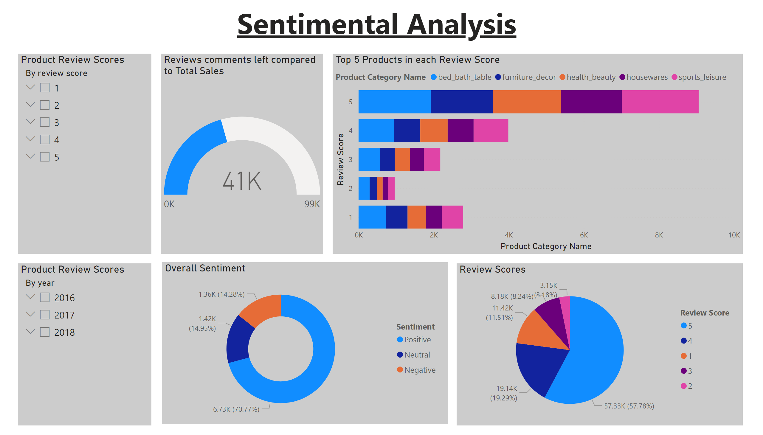
Sentimental Analysis
Notes:
Review Scores
No alt text provided
Top 5 Products in each Review Score
No alt text provided
Product Review Scores
No alt text provided
Reviews comments left compared to Total Sales
No alt text provided
Product Review Scores
No alt text provided
textbox
No alt text provided
Overall Sentiment
No alt text provided

Slide 10
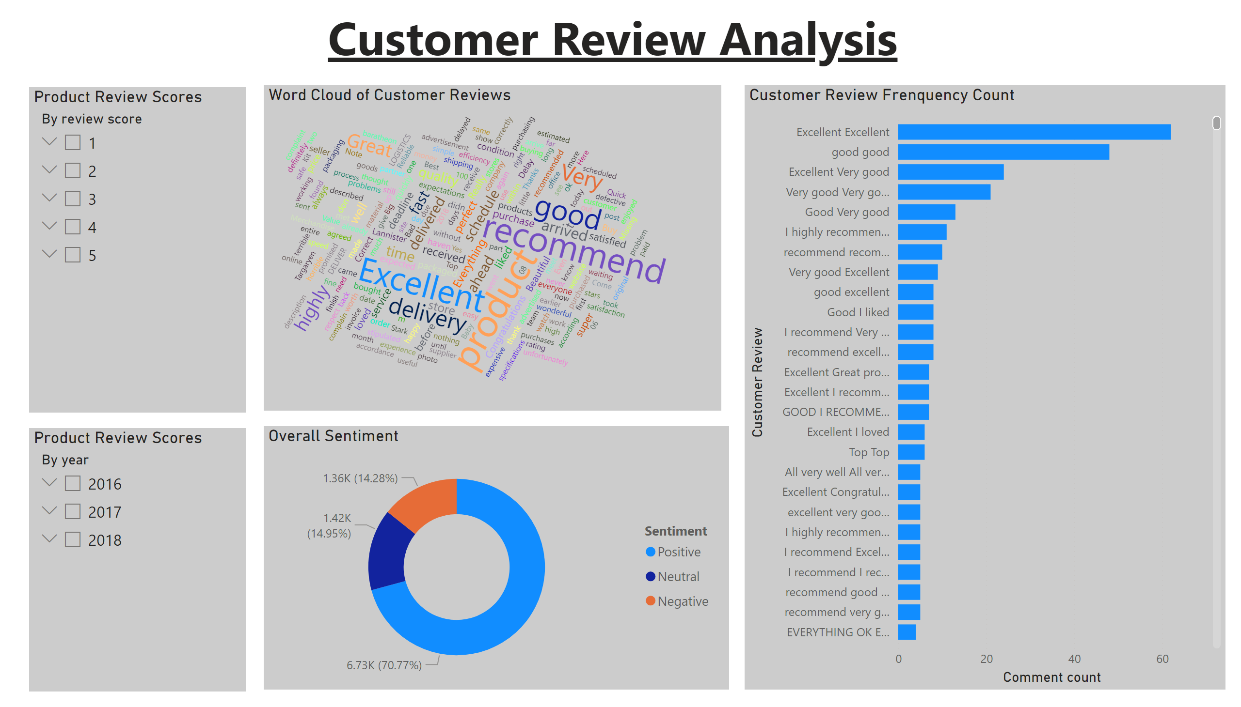
Customer Review Analysis
Notes:
Word Cloud of Customer Reviews
No alt text provided
Customer Review Frenquency Count
No alt text provided
Product Review Scores
No alt text provided
Product Review Scores
No alt text provided
Overall Sentiment
No alt text provided
textbox
No alt text provided

Slide 11
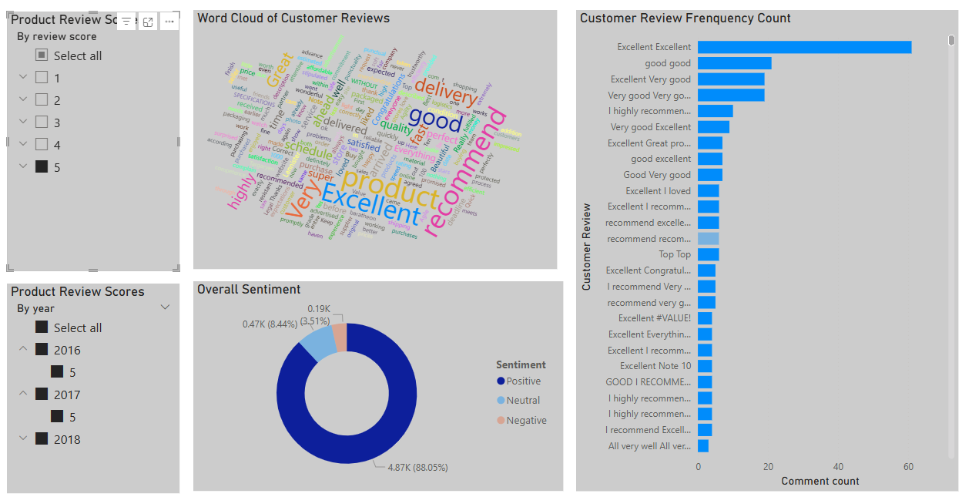
Customer Review Analysis
Reasons Behind Customer Satisfaction
Notes:
Word Cloud of Customer Reviews
No alt text provided
Customer Review Frenquency Count
No alt text provided
Product Review Scores
No alt text provided
Product Review Scores
No alt text provided
Overall Sentiment
No alt text provided
textbox
No alt text provided

Slide 12
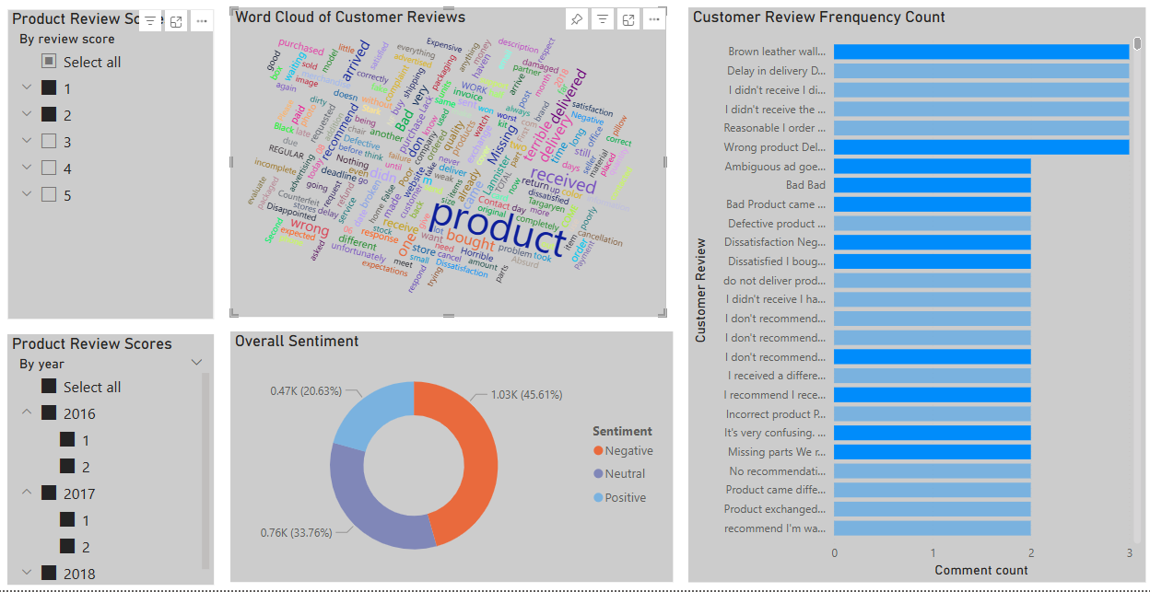
Customer Review Analysis
Reasons Behind Customer Dissatisfaction
Notes:
Word Cloud of Customer Reviews
No alt text provided
Customer Review Frenquency Count
No alt text provided
Product Review Scores
No alt text provided
Product Review Scores
No alt text provided
Overall Sentiment
No alt text provided
textbox
No alt text provided

Slide 13
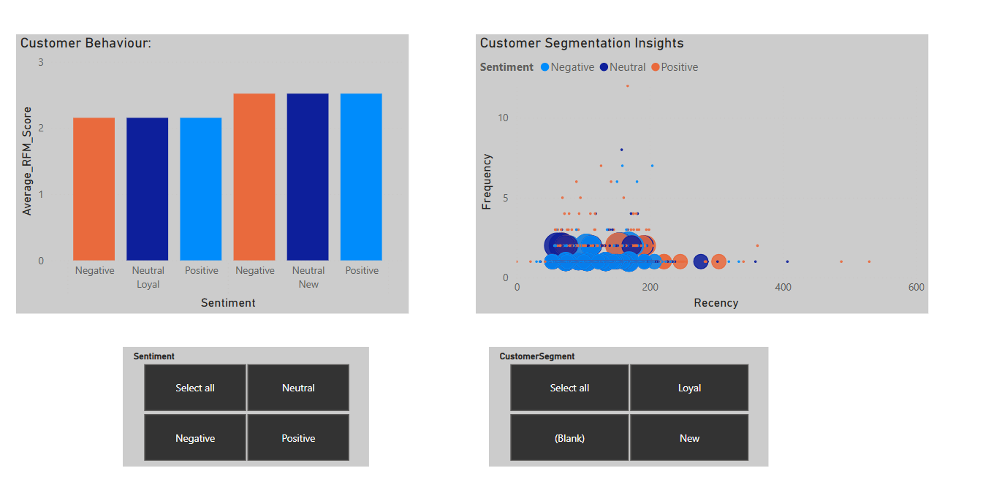
Exploring Customer Clusters: RFM Scores and Sentiment Analysis

Slide 14
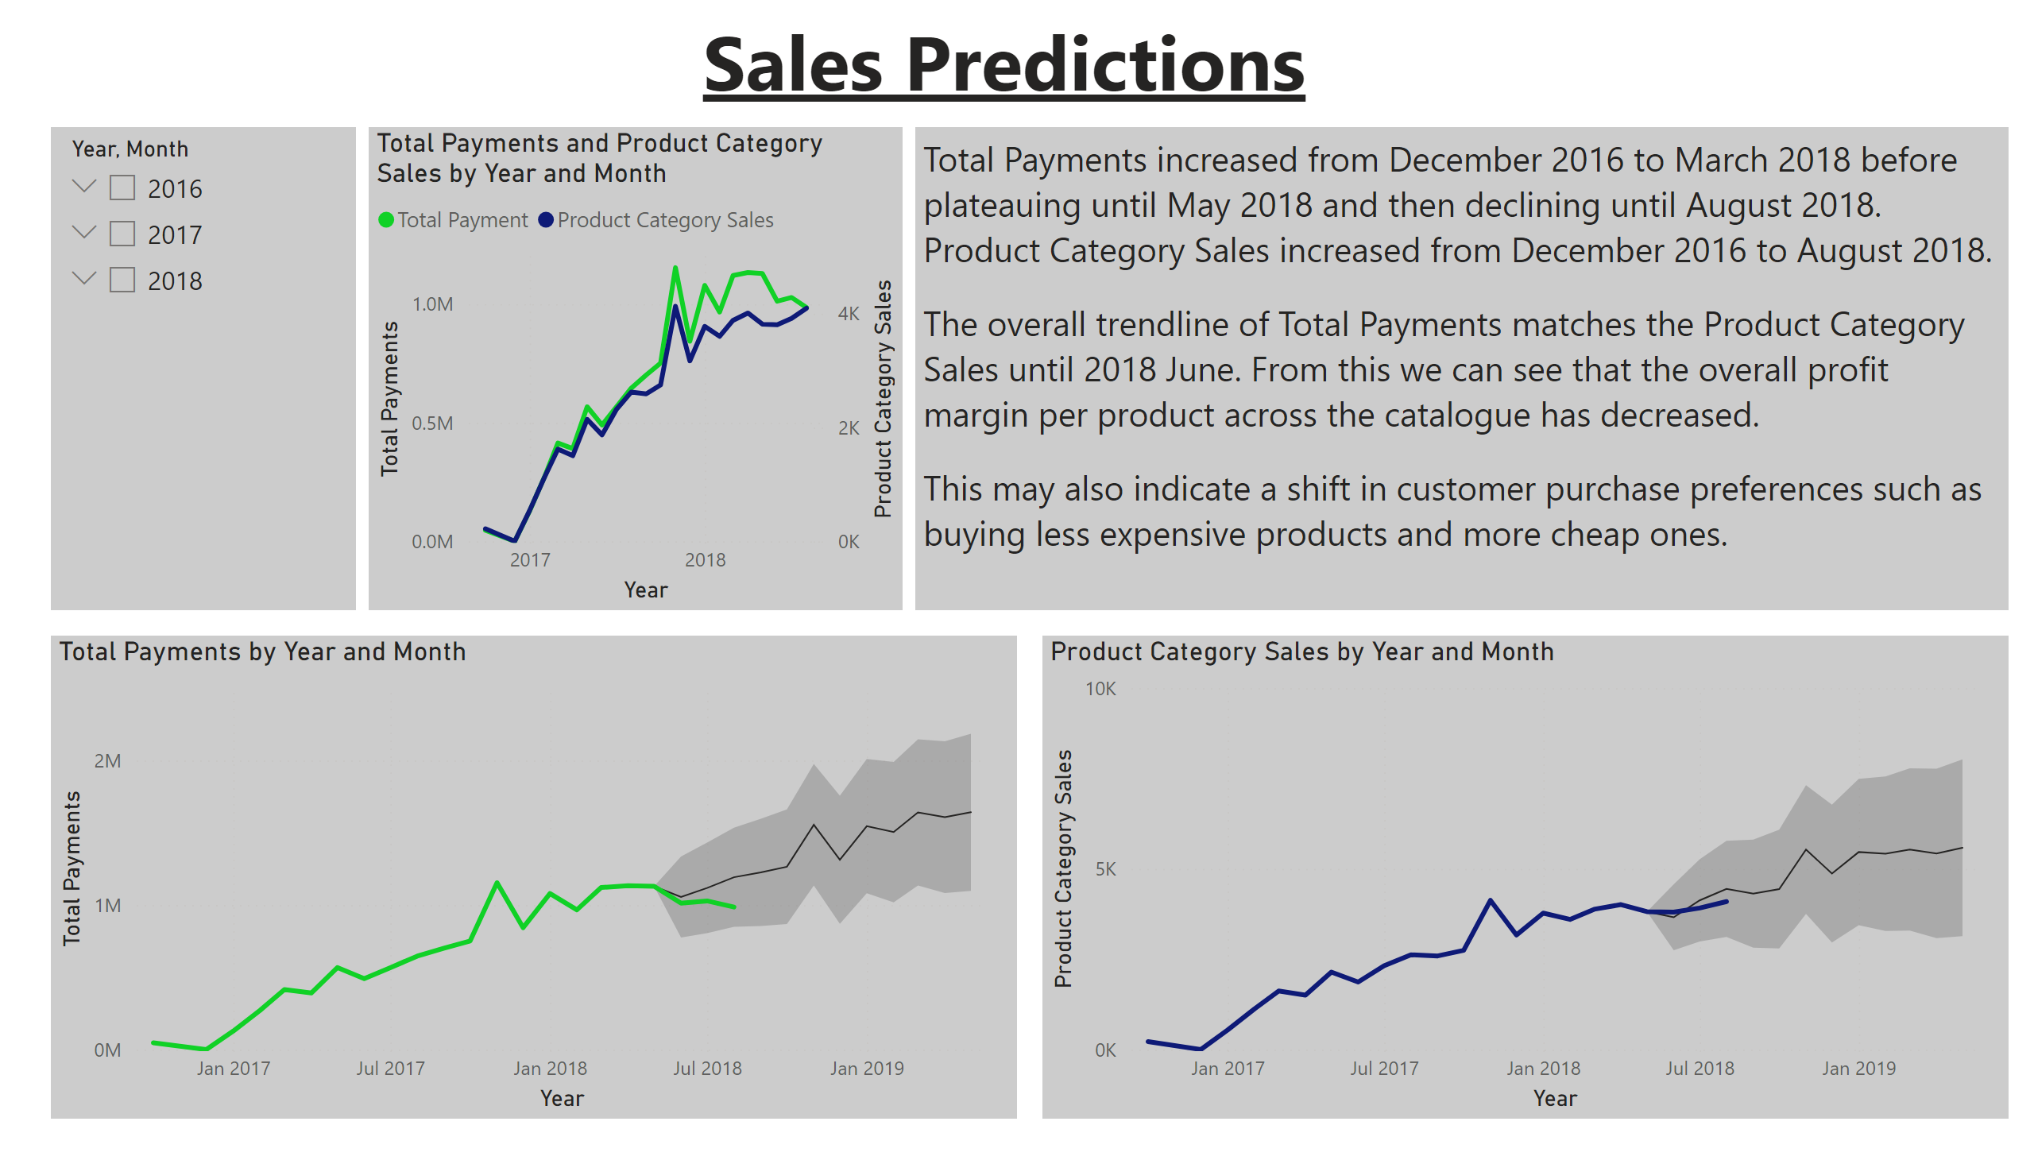
Sales Predictions
Notes:
Total Payments and Product Category Sales by Year and Month
No alt text provided
Total Payments by Year and Month
No alt text provided
Product Category Sales by Year and Month
No alt text provided
textbox
No alt text provided
textbox
No alt text provided
slicer
No alt text provided

Slide 15
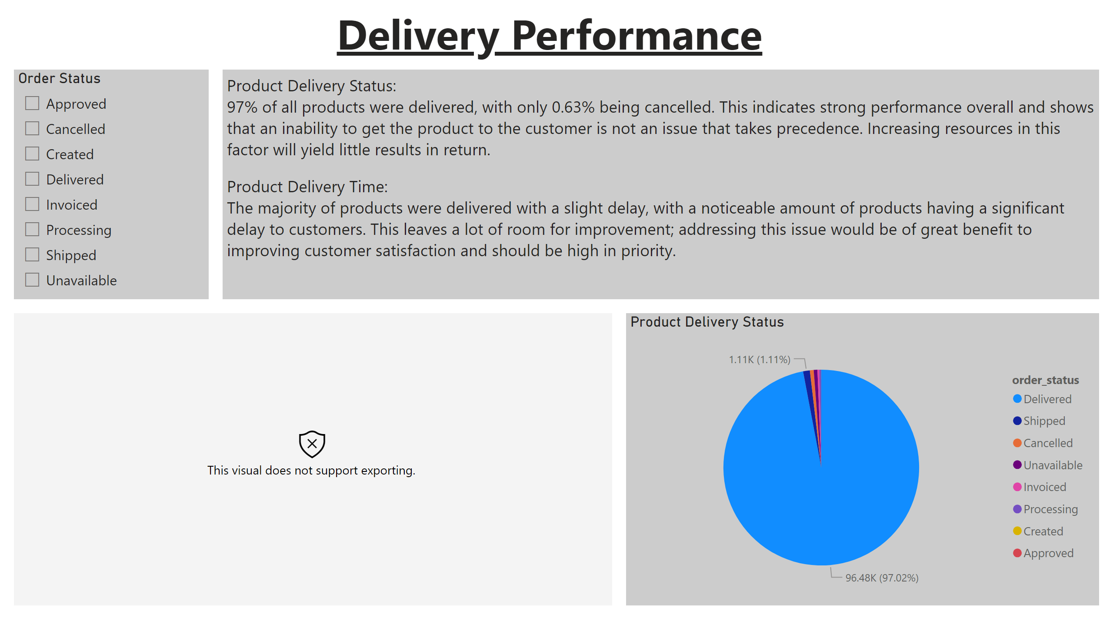
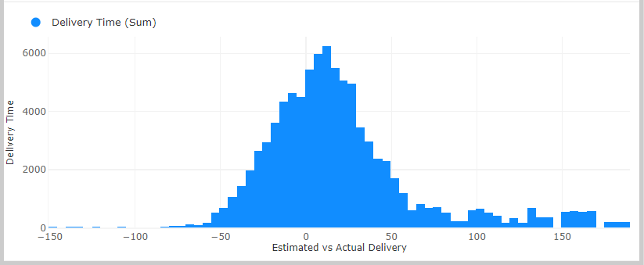
Delivery Time Performance 1
Notes:
histogramF963F133BA02A0B35D286F09F80E9C78
No alt text provided
Product Delivery Status
No alt text provided
textbox
No alt text provided
Order Status
No alt text provided
textbox
No alt text provided

Slide 16
Recommendations
- Enhance Delivery Processes:
- Collaborate with reliable logistics partners.
- Use predictive analytics for better delivery time estimates.
- Improve Customer Communication:
- Proactive updates on order status.
- Introduce live chat support.
- Focus on Top Categories:
- Expand product offerings in high-performing categories.
- Optimize marketing strategies for seasonal sales.
- Leverage Feedback:
- Act on common complaints to improve satisfaction.
- Encourage more detailed customer reviews.

Slide 17
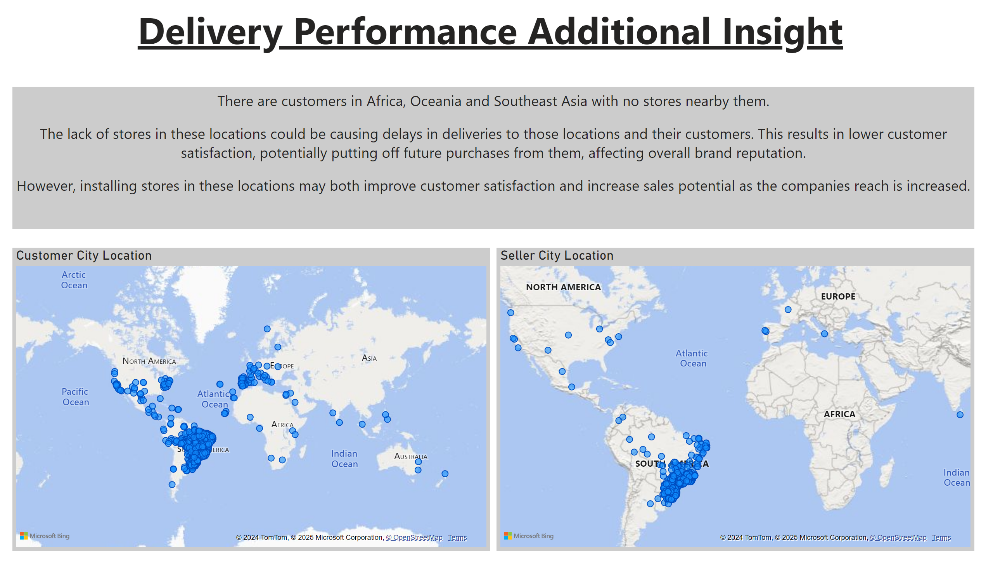
Delivery Time Performance 2
Notes:
Seller City Location
No alt text provided
Customer City Location
No alt text provided
textbox
No alt text provided
textbox
No alt text provided

Slide 18
Conclusion
- Summary:
- Data-driven insights reveal opportunities for Olist to improve delivery efficiency, customer satisfaction, and sales strategies.
- Next Steps:
- Implement recommended changes.
- Continuously monitor performance through dashboards.
- Final Thoughts:
- Data analytics is a powerful tool for driving business success.

Slide 19
Questions & Answers
The End
Thank You!

